Slide 1
Employee Data Analysis using Excel
STUDENT NAME:DURGA .B
REGISTER NO: 312212788(asunm14512022g38)
DEPARTMENT: B.COM (GENERAL)
COLLEGE: MAHALASHMI WOMEN’S COLLEGE OF ARTS AND SCIENCE.

Slide 2
PROJECT TITLE
Employee Performance Analysis using Excel

Slide 3


AGENDA
Problem Statement
Project Overview
End Users
Our Solution and Proposition
Dataset Description
Modelling Approach
Results and Discussion
Conclusion
3/21/2024 Annual Review

Slide 4

PROBLEM STATEMENT
Analyzing Gender Distribution and Data Completeness
Objective:
To analyze the gender distribution within a dataset and identify any inconsistencies or missing data related to gender information.
Scope:
Data Analysis: Examination of the provided dataset, which includes gender data, count of individuals by gender, and count of individuals with complete name information.
Data Completeness Assessment: Identification of any missing or incomplete gender data entries.
Gender Distribution Analysis: Comparison of the number of individuals identified as male, female, and those with missing or unspecified gender information.
Data Quality Assessment: Evaluation of the overall data quality and identification of potential errors or inconsistencies.

Slide 5
Expected Outcomes:
A comprehensive understanding of the gender distribution within the dataset.
Identification of any gaps or inconsistencies in gender data.
Recommendations for improving data quality and completeness.
Project Deliverables:
Data analysis report, including key findings and observations.
Assessment of data completeness and identification of missing data.
Analysis of gender distribution and comparison of counts.
Recommendations for improving data quality and consistency.

Slide 6

PROJECT OVERVIEW
Analyzing Departmental Resource Allocation:
Purpose: Optimize resource allocation for improved efficiency.
Goals: Identify imbalances, assess efficiency, and develop recommendations.
Scope: Data analysis, departmental comparison, efficiency assessment, and recommendations.
Methodology: Data collection, analysis, comparison, assessment, and recommendation development.
Deliverables: Data analysis report, comparative analysis, efficiency assessment, recommendations, and final report/presentation.

Slide 7

WHO ARE THE END USERS?
Directly affected by resource allocation decisions.
May be impacted by changes resulting from the project
Employees working within the various departments of the organization.

Slide 8

OUR SOLUTION AND ITS VALUE PROPOSITION
Solution and Value Proposition:
Solution: Departmental Resource Allocation Optimization Framework.
Components: Data collection, analysis, comparison, assessment, and recommendations.
Value Proposition: Improved efficiency, departmental performance, productivity, reduced costs, employee satisfaction, and informed decision-making.

Slide 9
Dataset Description
Dataset: Contains information about departmental resource allocation.
Fields: Department, Count - Department, Count - Name.
Assumptions: "Count - Name" likely represents individuals assigned to projects.
Potential Analysis: Departmental size comparison, resource allocation analysis, efficiency assessment, bottleneck identification, comparison to departmental goals.
Considerations: Data quality, privacy, and visualization.

Slide 10

THE "WOW" IN OUR SOLUTION
Potential Situations in the Data
Uneven Resource Distribution: Departments with high or low "Count - Name" compared to "Count - Department."
Project-Oriented Departments: High "Count - Name" relative to "Count - Department."
Administrative or Support Functions: Low "Count - Name" relative to "Count - Department."
Inefficient Resource Utilization: High "Count - Name" with low productivity.
Overburdened Departments: Consistently high "Count - Name" over time.
3/21/2024 Annual Review
10

Slide 11
MODELLING
Data Cleaning and Preparation:
Handling Missing Values: Addressing any missing data points for "Count - Department" or "Count - Name."
Data Normalization: Ensuring consistency in data formats and units of measurement.
Outlier Detection and Correction: Identifying and addressing any extreme or unusual values that might skew the analysis.
Feature Engineering:
Creating Derived Metrics: Consider creating additional metrics such as "Resource Allocation Ratio" (Count - Name / Count - Department) to provide a more comprehensive understanding of resource utilization.
Categorical Encoding: If the "Department" field is categorical, converting it into a numerical format suitable for modeling.
Exploratory Data Analysis (EDA):
Visualization: Creating visualizations (e.g., histograms, scatter plots, box plots) to explore the distribution of variables, identify relationships, and detect patterns.
Correlation Analysis: Assessing the correlation between "Count - Department" and "Count - Name" to understand the relationship between departmental size and resource allocation.
11

Slide 12
Model Selection and Training:
Regression Analysis: Using regression models (e.g., linear regression, multiple regression) to predict the "Count - Name" based on the "Count - Department" and other relevant features.
Classification Models: If the goal is to classify departments into categories based on their resource allocation patterns, consider using classification models (e.g., decision trees, random forests, logistic regression).
Model Evaluation:
Performance Metrics: Assessing the model's performance using appropriate metrics (e.g., R-squared, mean squared error, accuracy, precision, recall, F1-score).
Cross-Validation: Evaluating the model's generalization ability using techniques like k-fold cross-validation.
Interpretation and Insights:
Understanding Model Coefficients: Interpreting the coefficients of the regression model to understand the impact of "Count - Department" and other features on "Count - Name."
Identifying Significant Predictors: Determining which features are most influential in predicting "Count - Name."

Slide 13
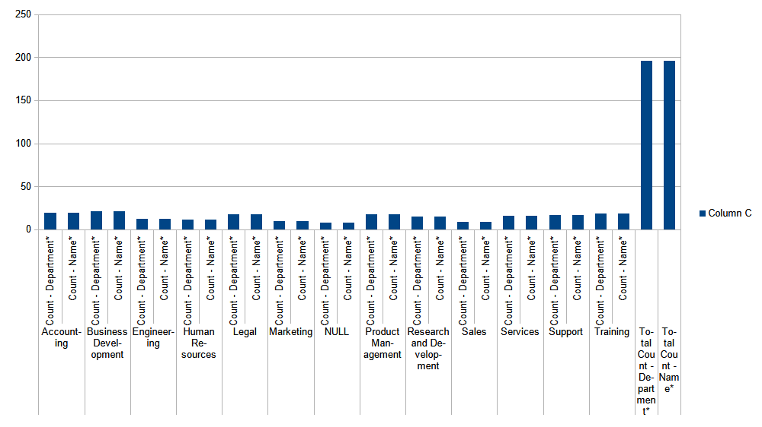
RESULTS
13

Slide 14
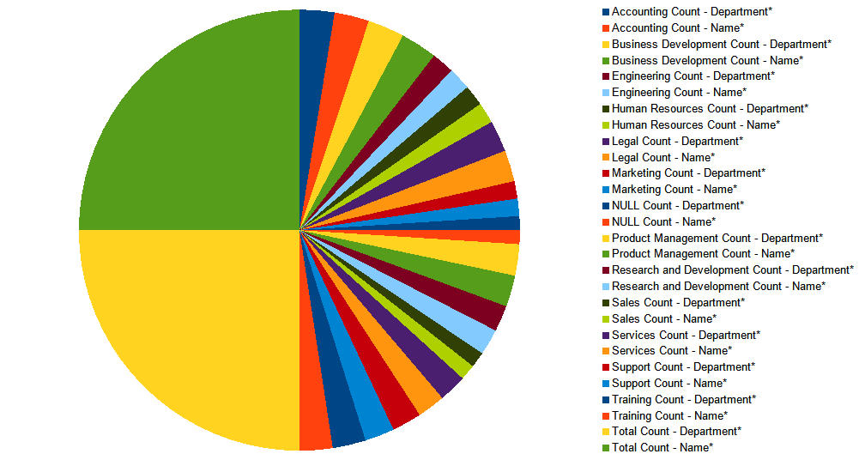

Slide 15
conclusion
Uneven resource distribution.
Project-oriented focus.
Administrative and support functions.
Inefficient resource utilization.
Overburdened departments.
Recommendations:
Re-evaluate resource allocation strategies.
Implement balanced resource distribution.
Promote strategic planning.
Enhance efficiency and productivity.
Address overburdened departments.

